Slide 1

Geometry
Unit 6, Lesson 8 Proving Triangle Similarity – Part 1 Volume 1, pg. 332

Slide 2


Benchmark
MA.912.GR.1.2
Prove triangle congruence or similarity using Side-Side-Side, Side-Angle-Side, Angle-Side-Angle, Angle-Angle-Side, Angle-Angle, and Hypotenuse-Leg.
volume 1, pg. 332

Slide 3
Integrated Mathematical Thinking and Reasoning Standards
MA.K12.MTR.1.1 Actively participate in effortful learning both individually and collectively.
MA.K12.MTR.2.1 Demonstrate understanding by representing problems in multiple ways.
MA.K12.MTR.3.1 Complete tasks with mathematical fluency.
MA.K12.MTR.4.1 Engage in discussions that reflect on the mathematical thinking of self and others.
MA.K12.MTR.5.1 Use patterns and structure to help understand and connect mathematical concepts.
MA.K12.MTR.6.1 Assess the reasonableness of solutions.
volume 1, pg. 332

Slide 4

Learning Target
I can use triangle similarity to prove triangles are similar.
volume 1, pg. 332

Slide 5

Warm-Up
volume 1, pg. 332

Slide 6
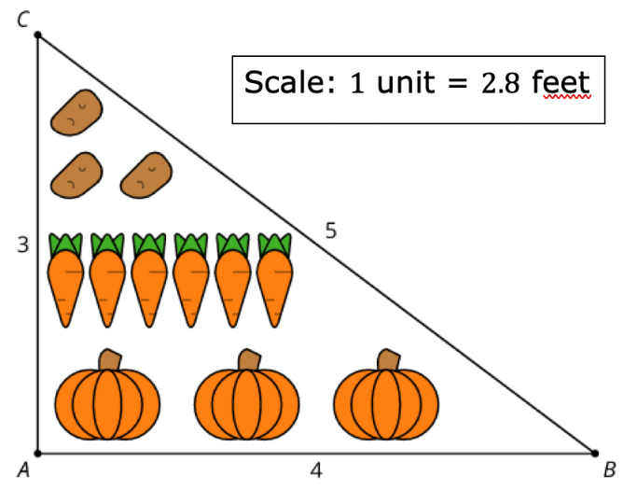

6.8.1 Warm-Up: Vegetable Garden
$∆ABC$ is used to create a plan for a vegetable garden.
What do you notice about the plan?
Write at least three equivalent ratios or equations using lengths from both the diagram and the full-size garden.
volume 1, pg. 332

Slide 7

Collaboration
volume 1, pg. 333

Slide 8

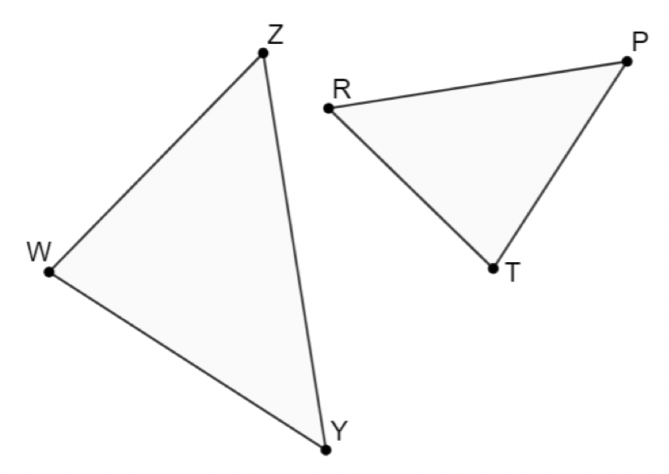
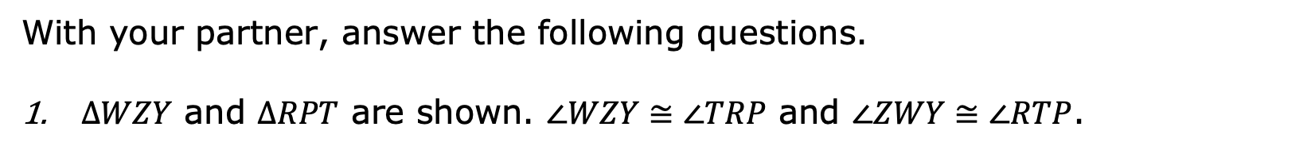
6.8.2 Collaboration: Proving Triangle Similarity
With your partner, answer the following questions.
$∆WZY$ and $∆RPT$ are shown. $∠WZY≅∠TRP$ and $∠ZWY≅∠RTP$.
volume 1, pg. 333

Slide 9
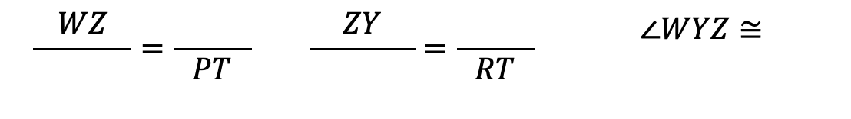
Mark the figure using the given information.
What similarity theorem can be applied to show that the triangles are similar?
Write the similarity statement.
Complete each.
$$\frac{WZ}{ }=\frac{ }{PT}$$ | $$\frac{ZY}{ }=\frac{ }{RT}$$ | $$∠WYZ≅$$
volume 1, pg. 333

Slide 10
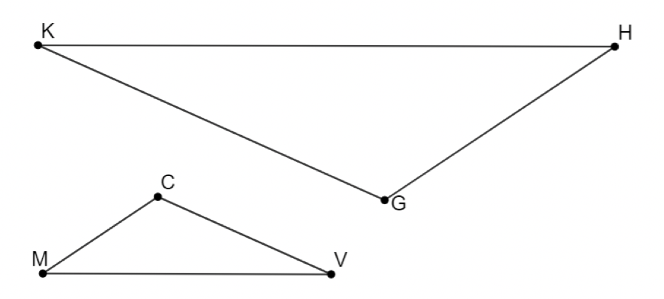
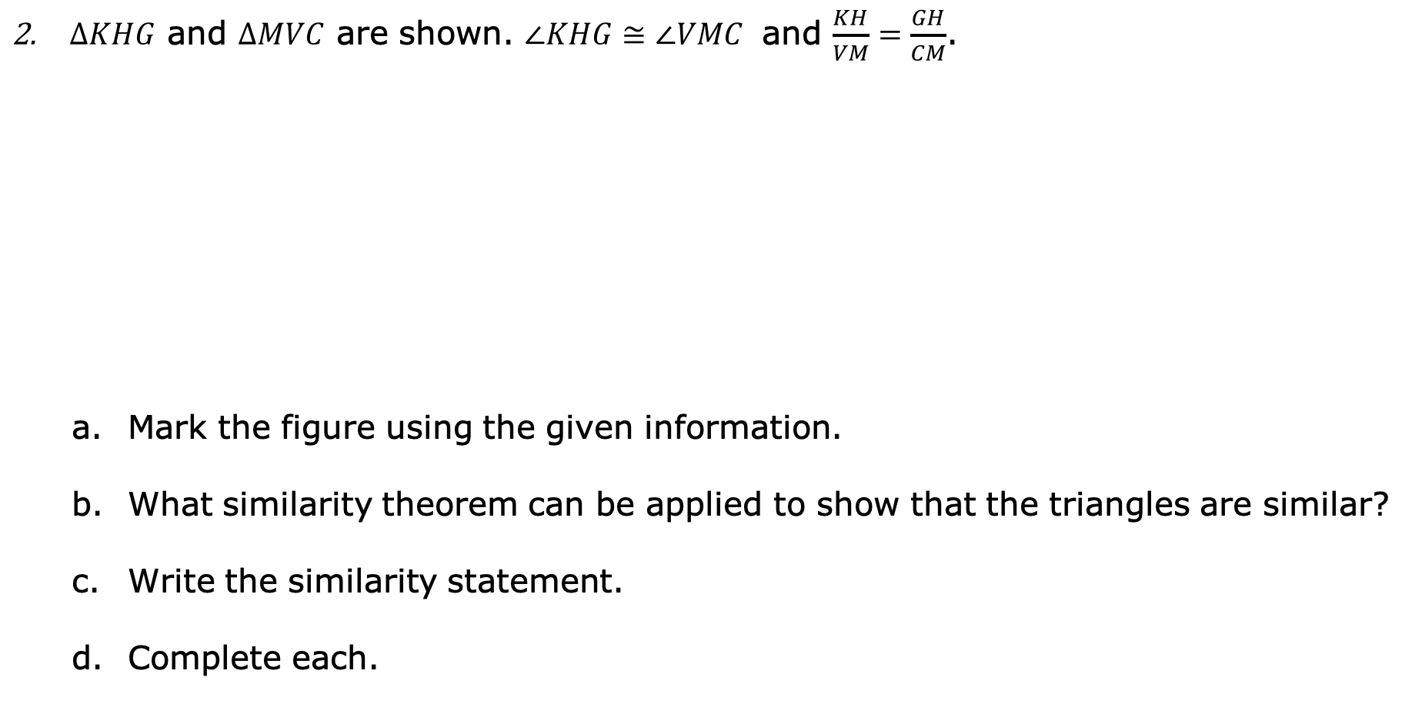
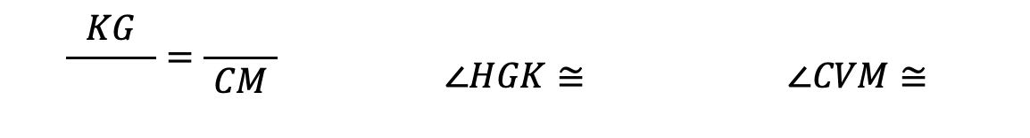
$∆KHG$ and $∆MVC$ are shown. $∠KHG≅∠VMC$ and $\frac{KH}{VM}=\frac{GH}{CM}$.
Mark the figure using the given information.
What similarity theorem can be applied to show that the triangles are similar?
Write the similarity statement.
Complete each.
$$\frac{KG}{ }=\frac{ }{CM}$$ | $$∠HGK≅$$ | $$∠CVM≅$$
volume 1, pg. 333

Slide 11

Guided Instruction
volume 1, pg. 334

Slide 12
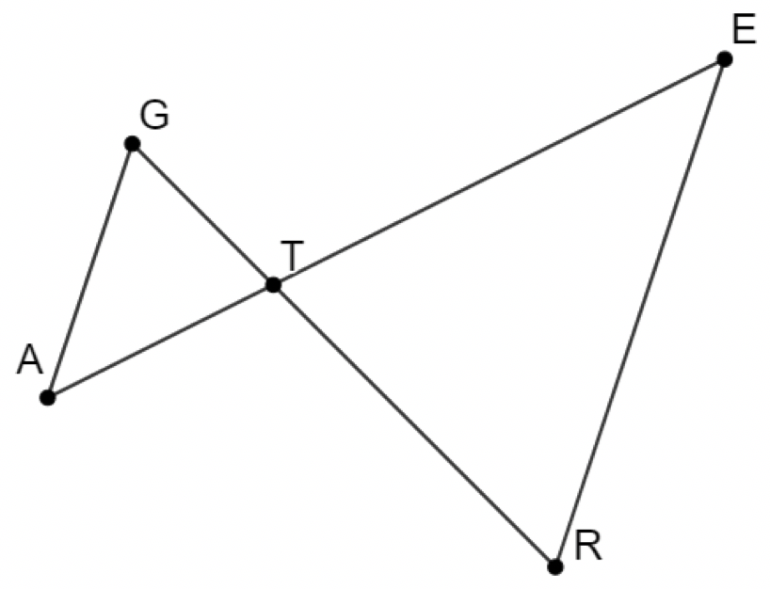
6.8.3 Guided Instruction: Proving Triangle Similarity
$ΔGTA$ and $ΔTER$ are shown, and $\overline{GA}∥\overline{ER}.$
volume 1, pg. 334

Slide 13
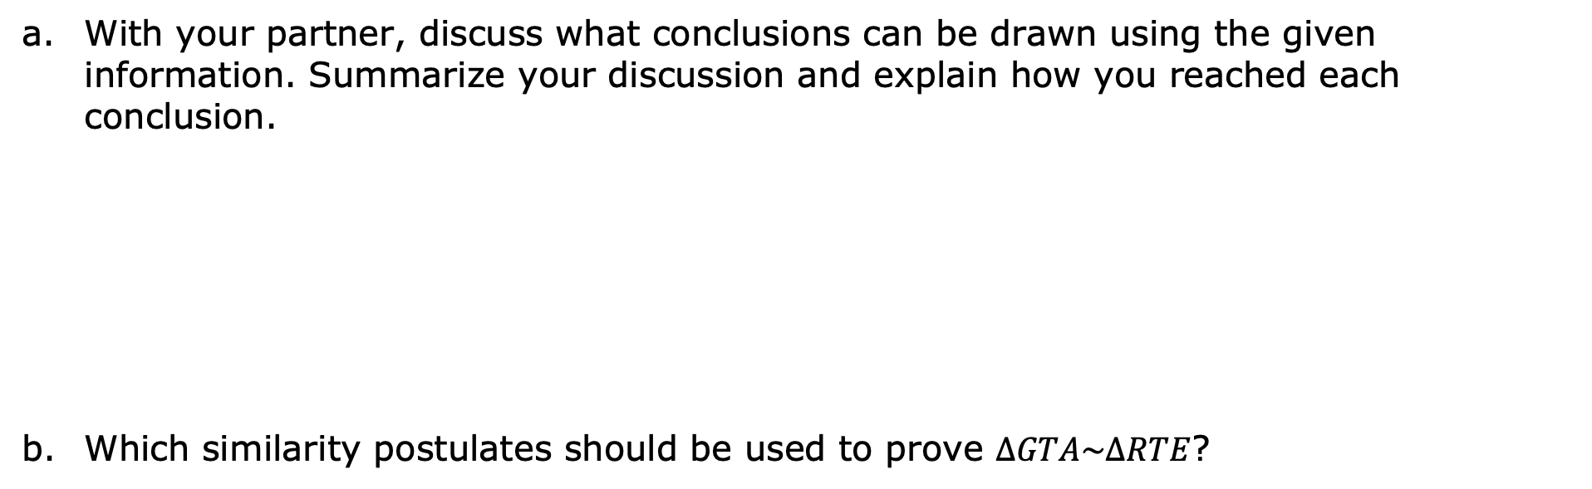
With your partner, discuss what conclusions can be drawn using the given information. Summarize your discussion and explain how you reached each conclusion.
Which similarity postulates should be used to prove $∆GTA\sim ∆RTE$?
volume 1, pg. 334

Slide 14
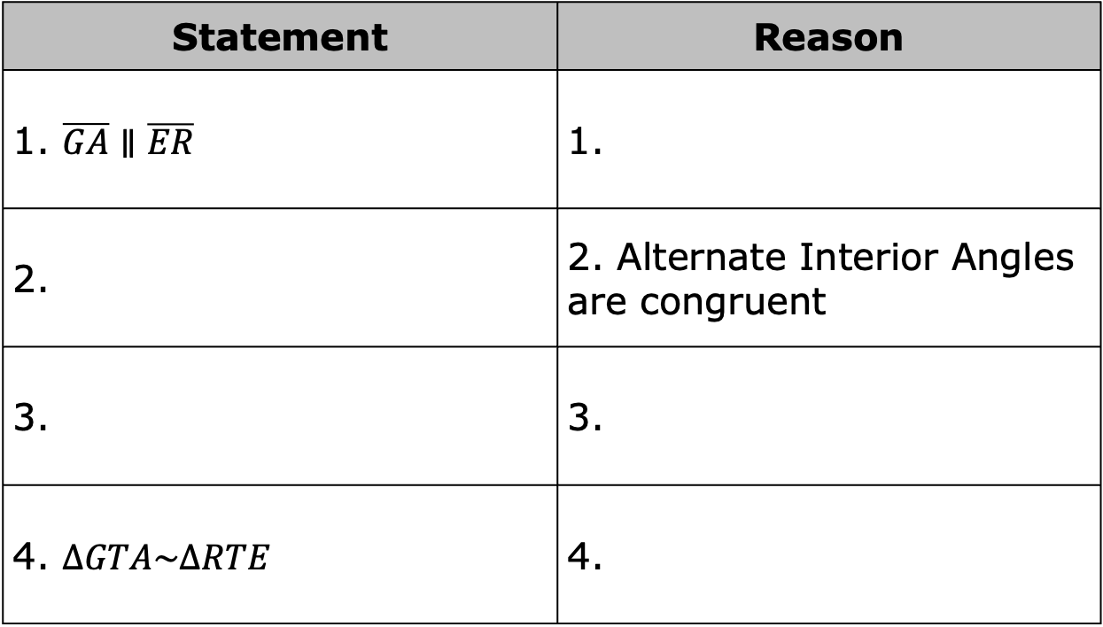
Complete the two-column proof.
Statement | Reason
1. $\overline{GA}∥\overline{ER}$ | 1.
2. | 2. Alternate Interior Angles are congruent
3. | 3.
4. $∆GTA\sim ∆RTE$ | 4.
volume 1, pg. 334

Slide 15
Ask two classmates about their proof. Record their step 3 statement and reason. You are the only person who should write in the first two columns of the table. Have the person initial next to your summary stating that your summary was correct.
Step 3 Statement | Step 3 Reason | Initials
Discuss with your partner the two different ways that $∆GTA\sim ∆RTE$ can be proved.
volume 1, pg. 334

Slide 16
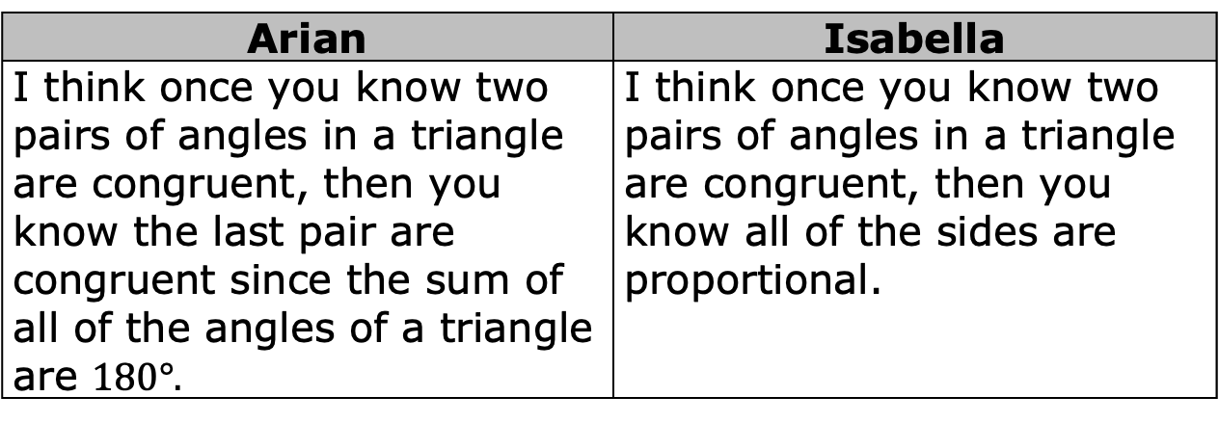
Explain why you do not need to state three congruent angles in your two-column proof.
Arian and Isabella were discussing why there is no Angle-Angle-Angle Similarity Theorem.
Arian | Isabella
I think once you know two pairs of angles in a triangle are congruent, then you know the last pair are congruent since the sum of all of the angles of a triangle are $180°.$ | I think once you know two pairs of angles in a triangle are congruent, then you know all of the sides are proportional.
Discuss with your partner why Arian and Isabella’s arguments could also be applied to show why Angle-Side-Angle similarity and Angle-Angle-Side similarity is not needed to prove similarity. Summarize your discussion.
volume 1, pg. 335

Slide 17
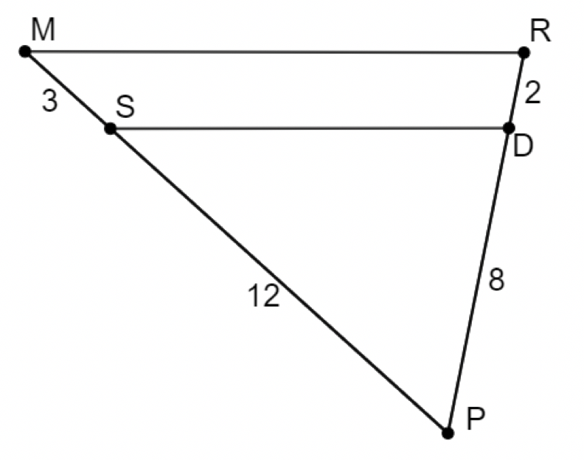
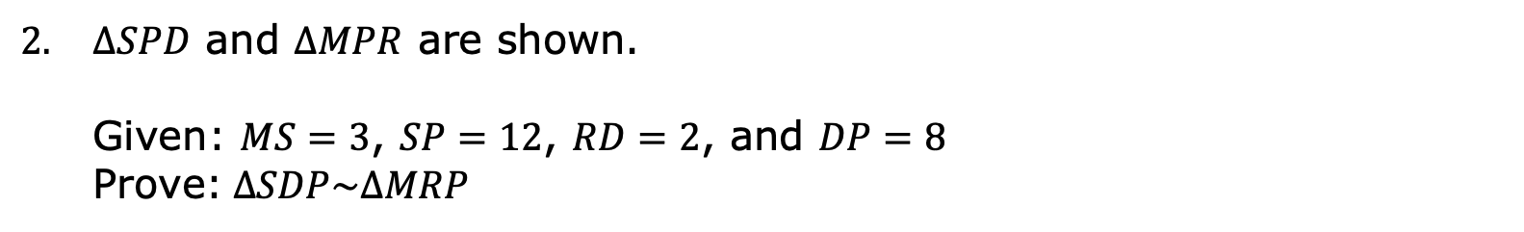
$ΔSPD$ and $ΔMPR$ are shown.
Given: $MS=3$, $SP=12$, $RD=2$, and $DP=8$
Prove:$∆SDP\sim ∆MRP$
volume 1, pg. 335

Slide 18
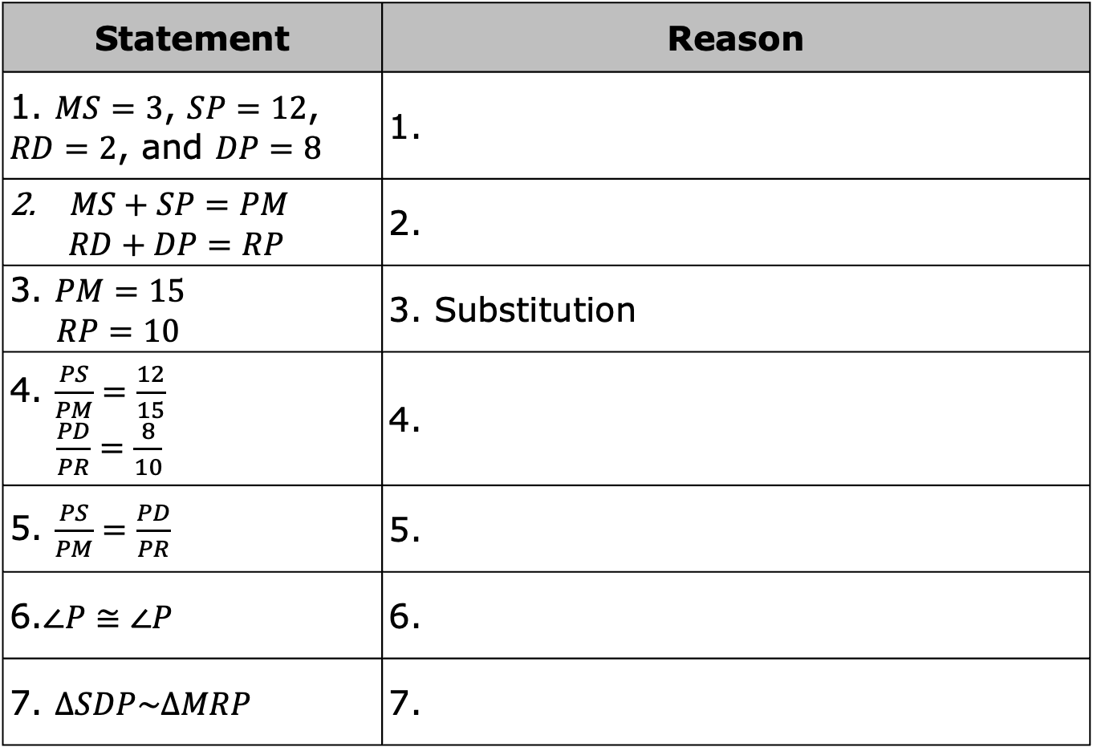
Statement | Reason
1. $MS=3$, $SP=12$, $RD=2$, and $DP=8$ | 1.
$MS+SP=PM$ $$RD+DP=RP$$ | 2.
3. $PM=15$ $RP=10$ | 3. Substitution
4. $\frac{PS}{PM}=\frac{12}{15}$ $\frac{PD}{PR}=\frac{8}{10}$ | 4.
5. $\frac{PS}{PM}=\frac{PD}{PR}$ | 5.
6.$∠P≅∠P$ | 6.
7. $∆SDP\sim ∆MRP$ | 7.
volume 1, pg. 335

Slide 19

Try It
volume 1, pg. 336

Slide 20

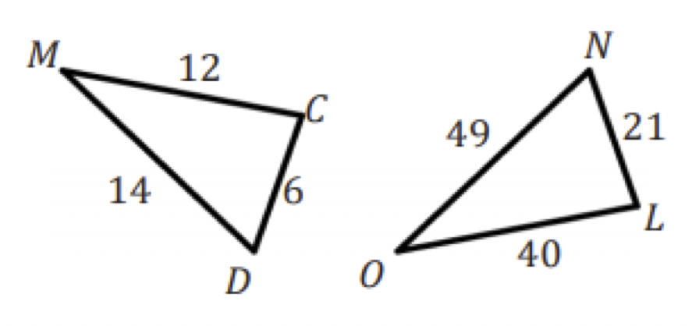
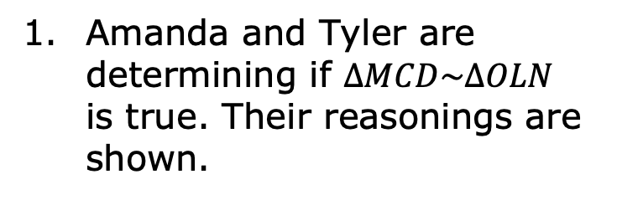
6.8.4 Try It: Triangle Similarity
Amanda and Tyler are determining if $∆MCD\sim ∆OLN$ is true. Their reasonings are shown.
Amanda’s Answer | Tyler’s Answer
No, the triangles are not similar because the corresponding sides are not proportional. | Yes, the triangles are similar because the corresponding sides are proportional.
Who do you agree with? Explain your reasoning.
volume 1, pg. 336

Slide 21
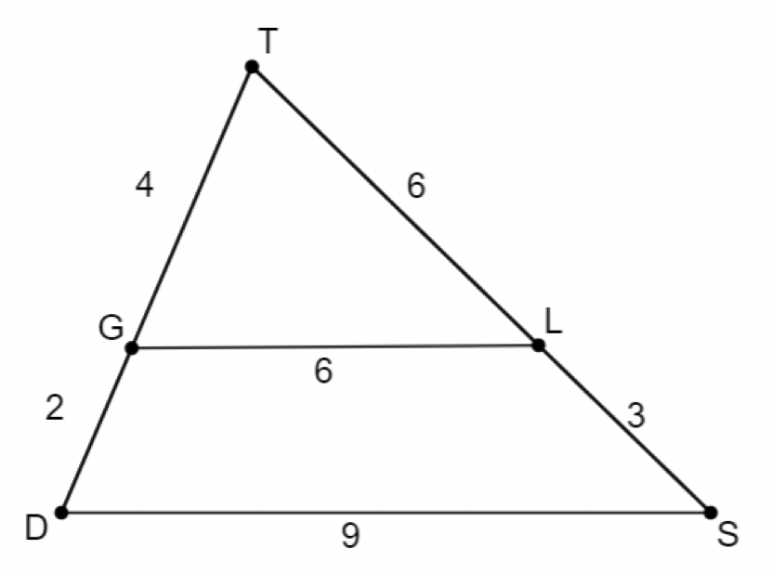
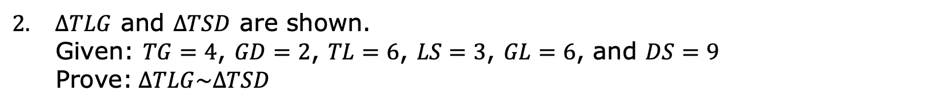
$ΔTLG$ and $ΔTSD$ are shown.
Given: $TG=4$, $GD=2$, $TL=6$, $LS=3$, $GL=6$, and $DS=9$
Prove:$∆TLG\sim ∆TSD$
volume 1, pg. 336

Slide 22
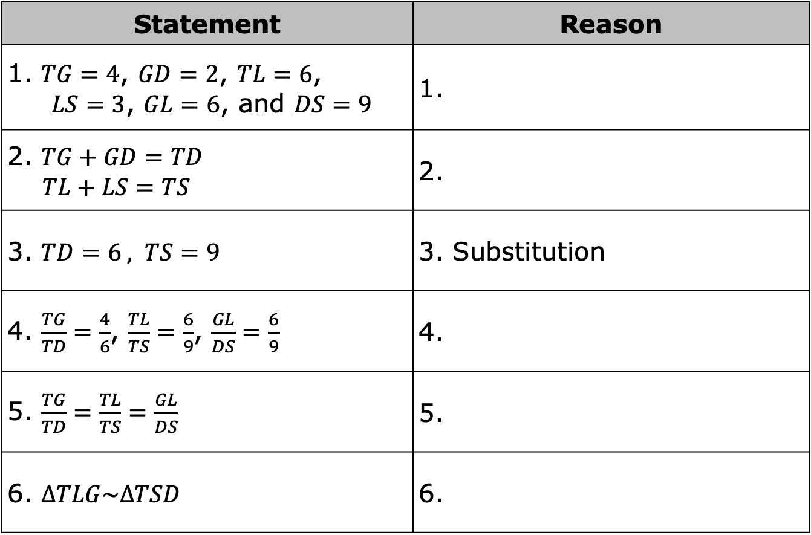
Statement | Reason
1. $TG=4$, $GD=2$, $TL=6$, $LS=3$, $GL=6$, and $DS=9$ | 1.
2. $TG+GD=TD$ $TL+LS=TS$ | 2.
3. $TD=6 , TS=9$ | 3. Substitution
4. $\frac{TG}{TD}=\frac{4}{6}$, $\frac{TL}{TS}=\frac{6}{9}$, $\frac{GL}{DS}=\frac{6}{9}$ | 4.
5. $\frac{TG}{TD}=\frac{TL}{TS}=\frac{GL}{DS}$ | 5.
6. $∆TLG\sim ∆TSD$ | 6.
volume 1, pg. 336

Slide 23

Wrap-Up
volume 1, pg. 337

Slide 24
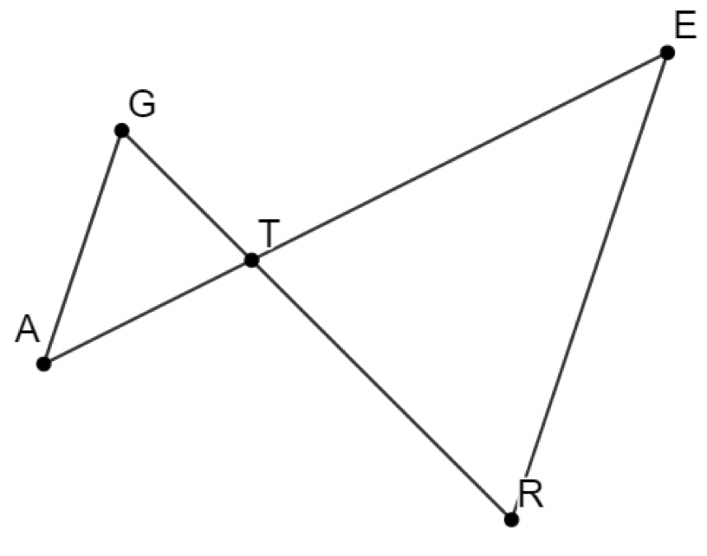

6.8.5 Wrap-Up: Ticket Out the Door
$ΔGTA$ and $ΔTER$ are shown.
Given: $TA=\frac{2}{3}TE$ and $TG=\frac{2}{3}RT$
Prove: $∆GTA\sim ∆RTE$
volume 1, pg. 337

Slide 25
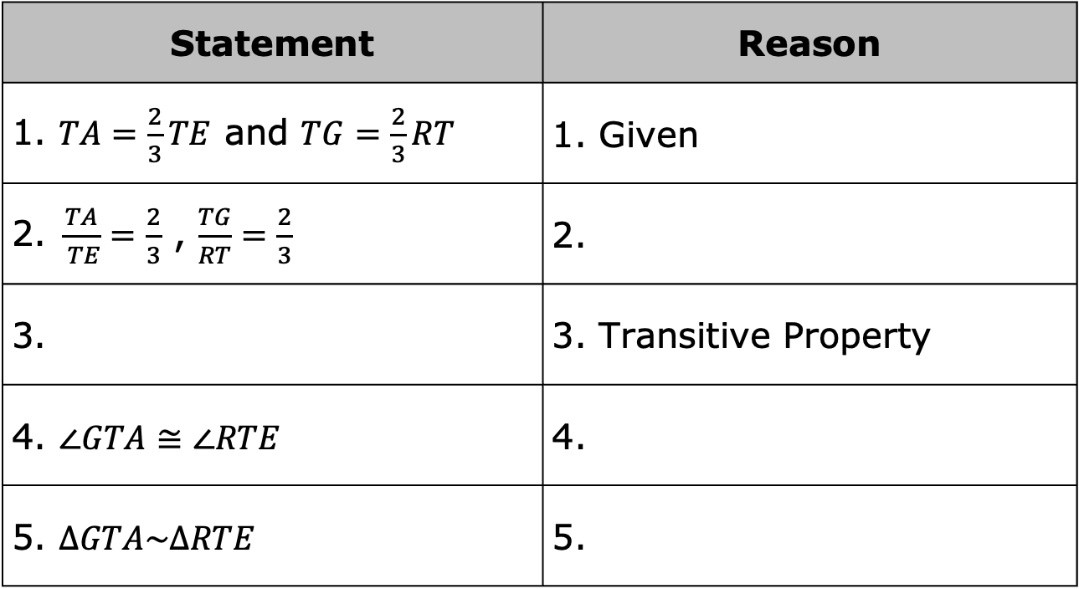
Complete the two-column proof.
Statement | Reason
1. $TA=\frac{2}{3}TE$ and $TG=\frac{2}{3}RT$ | 1. Given
2.$\frac{TA}{ TE}=\frac{2}{3}$ , $\frac{TG}{RT}=\frac{2}{3}$ | 2.
3. | 3. Transitive Property
4. $∠GTA≅∠RTE$ | 4.
5. $∆GTA\sim ∆RTE$ | 5.
volume 1, pg. 337

